Slide 1
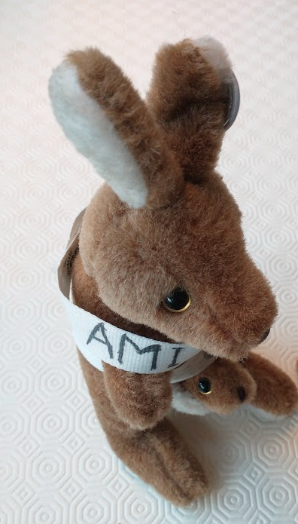



Can we Trust AI?
Peter Murray-Rust
Yusuf Hamied Dept of Chemistry,
University of Cambridge
NIPGR, Delhi, IN, 2025-01-21
AMI

Slide 2
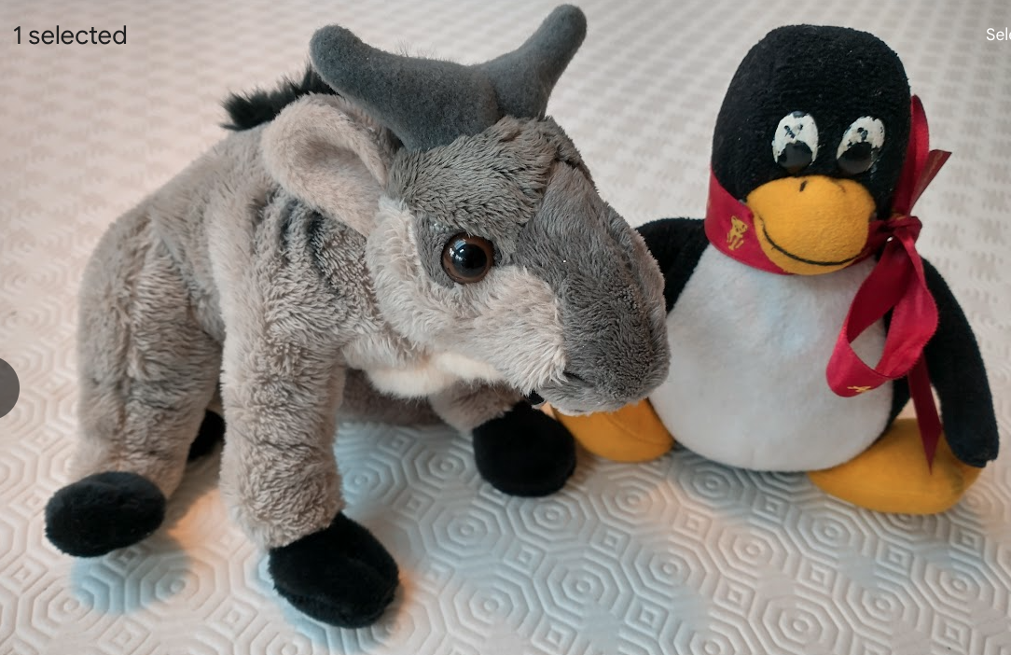
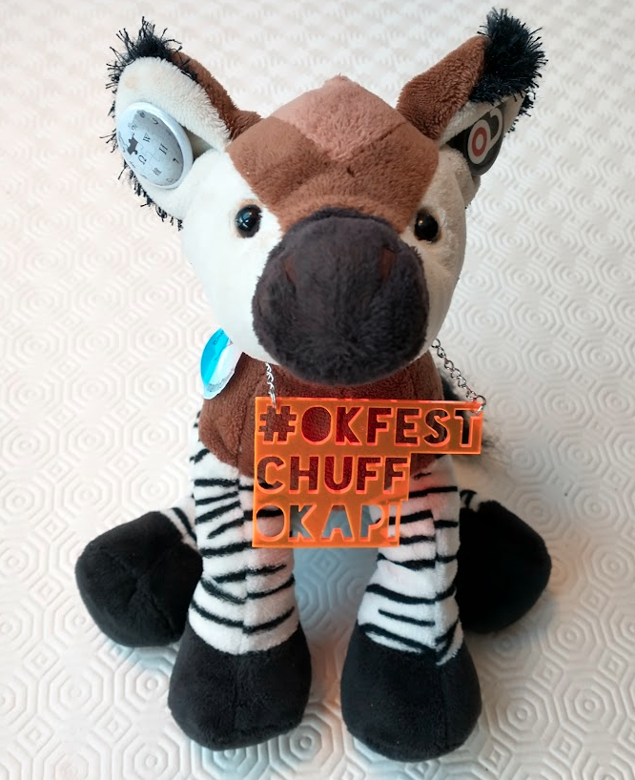
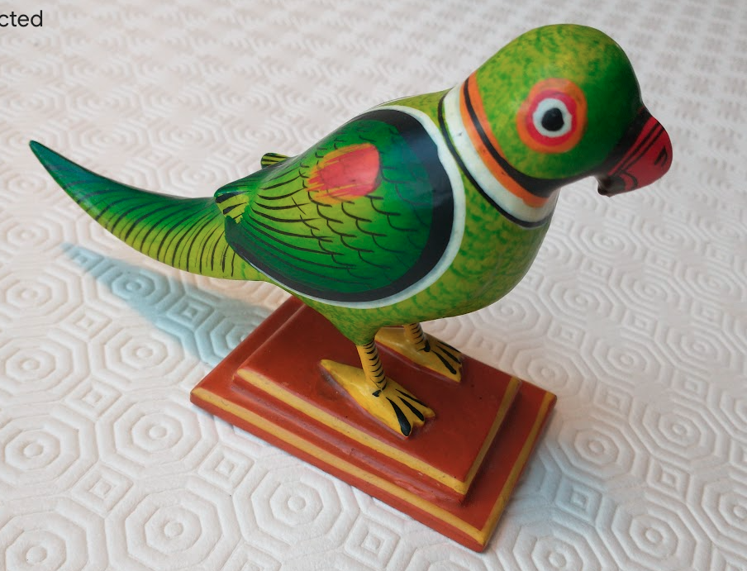
Openness and Responsible AI
Peter Murray-Rust
Yusuf Hamied Dept of Chemistry,
University of Cambridge
NIPGR, Delhi, IN, 2025-01-21
Can we trust AI?
YES and NO
Free and Open Source (F/OSS)
AMI, semanticClimate
Polly,
stochasticParrot
OpenKnowledge
and OpenData

Slide 3
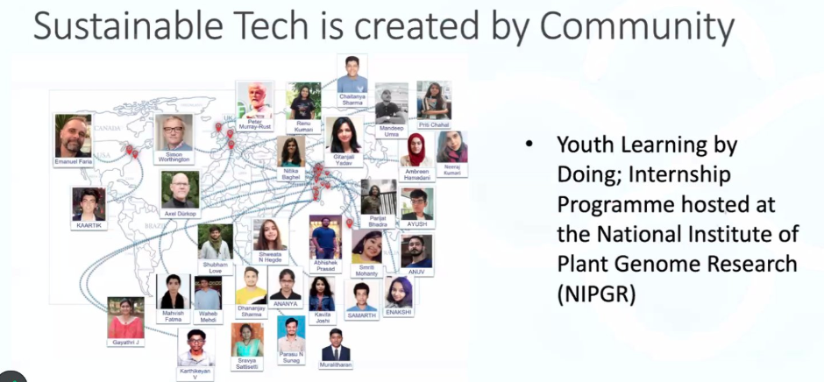
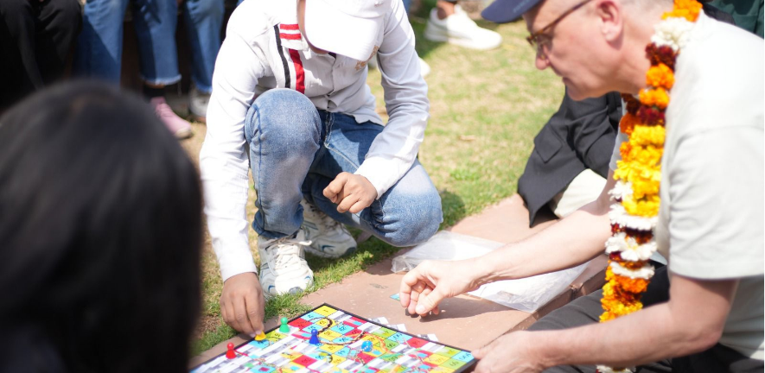
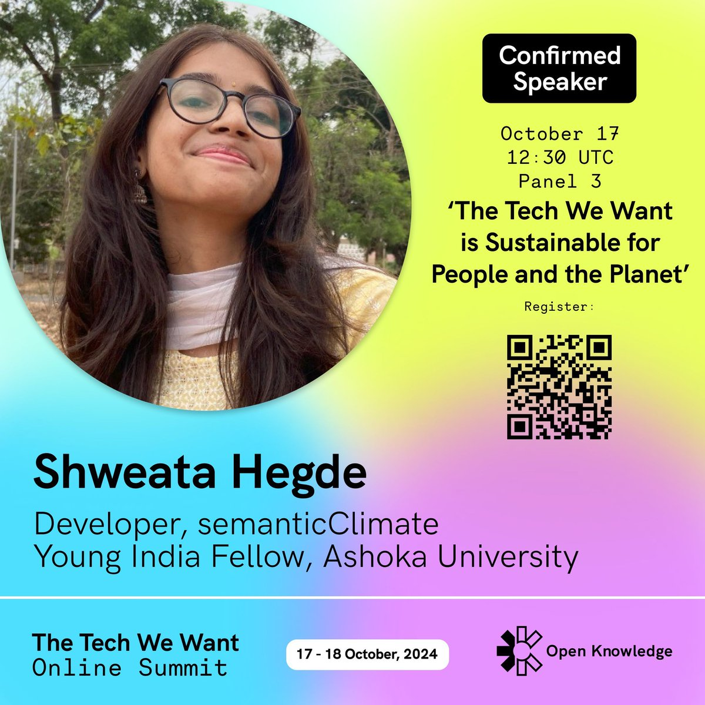
semanticClimate
Builds a community
Automatically collects climate information , makes it semantic, annotates it:
for learning, re-use and advocacy

Slide 4
Why do you trust Alphafold?
Because it’s trained on real OPEN Data
And the Database is partnered by EBI
AMI, semanticClimate

Slide 5
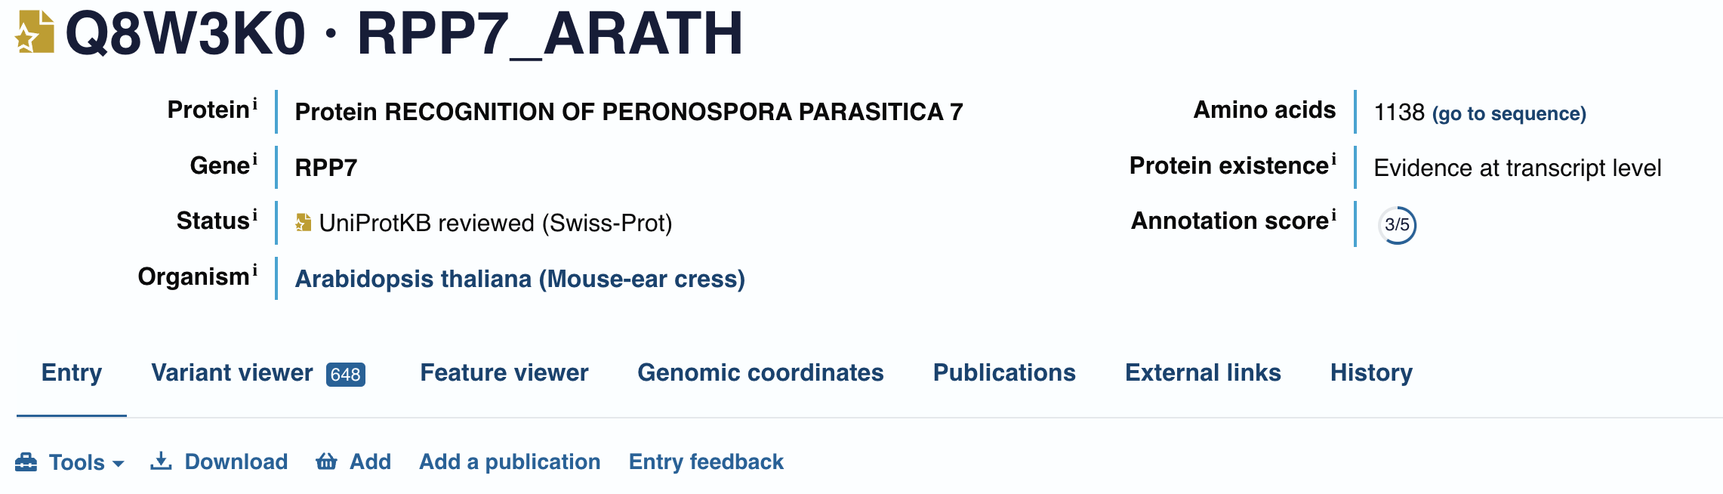
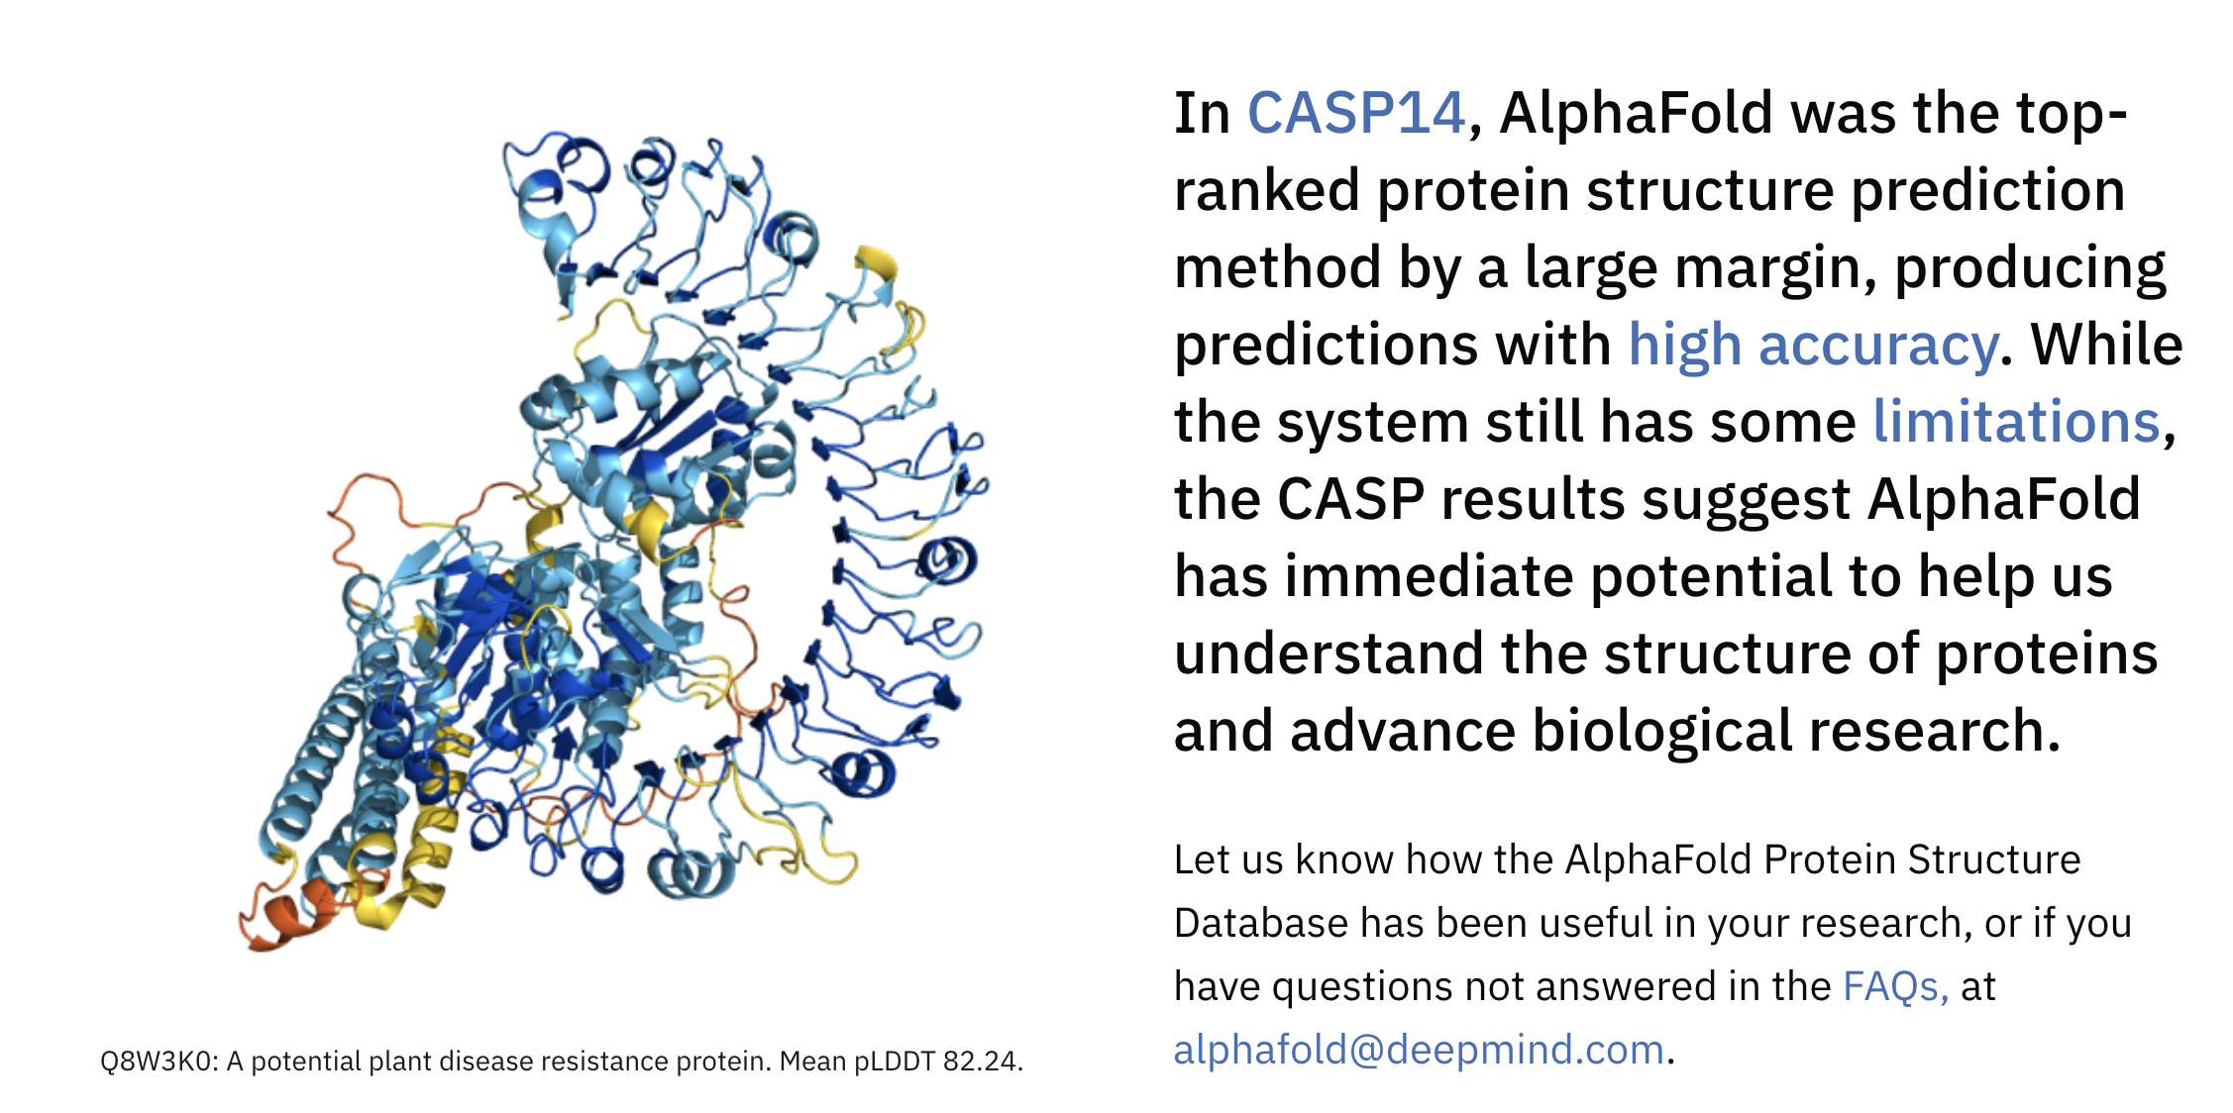
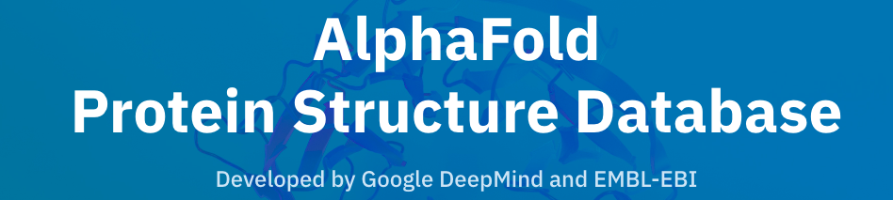
European
Bioinformatics
Institute
https://www.uniprot.org/uniprotkb/Q8W3K0/entry

Slide 6
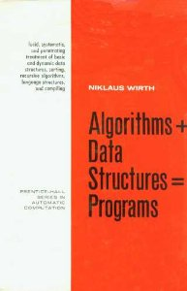
AI/ML components + licences
Code (Github, PyPI, etc.)
Data (e.g. Bioinformatics, Genbank, PDB, Uniprot) FAIR
Text (unstructured, copyrighted) ??

Slide 7
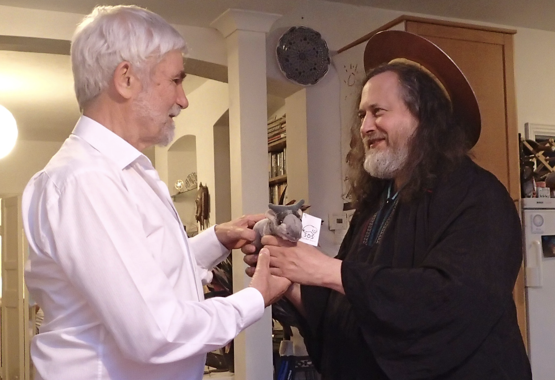
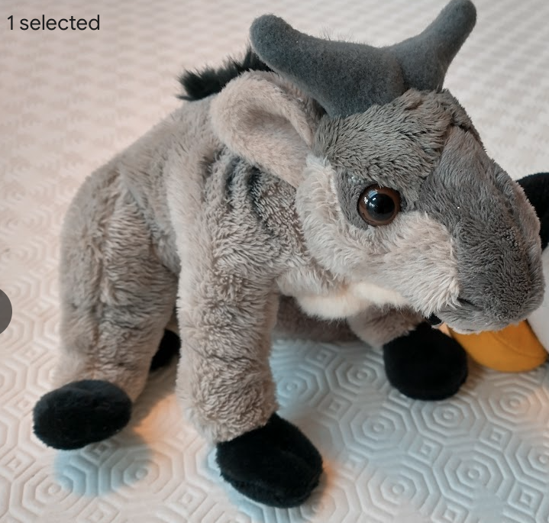
Software freedoms
0. to run the program for any purpose
1. to study how the program works (source code )
2. to redistribute copies so you can help your neighbor.
3. To distribute copies of your modified versions
https://en.wikipedia.org/wiki/The_Free_Software_Definition
GNU
https://blogs.ch.cam.ac.uk/pmr/2014/07/01/visit-of-richard-stallman-rms-to-cambridge/

Slide 8
Software freedoms
These have inspired the
Open Data/Knowledge Movements
0. to run the program for any purpose
1. to study how the program works (source code )
2. to redistribute copies so you can help your neighbor.
3. To distribute copies of your modified versions
https://en.wikipedia.org/wiki/The_Free_Software_Definition
GNU
https://blogs.ch.cam.ac.uk/pmr/2014/07/01/visit-of-richard-stallman-rms-to-cambridge/

Slide 9
The Bermuda Principles set out rules for the rapid and public release of
DNA sequence data.
The three principles retained originally were:
Automatic release of sequence assemblies larger than 1 kb
(preferably within 24 hours).
Immediate publication of finished annotated sequences.
Aim to make the entire sequence freely available in the public domain
for both research and development in order to maximise benefits to society.
(https://en.wikipedia.org/wiki/Bermuda_Principles )

Slide 10
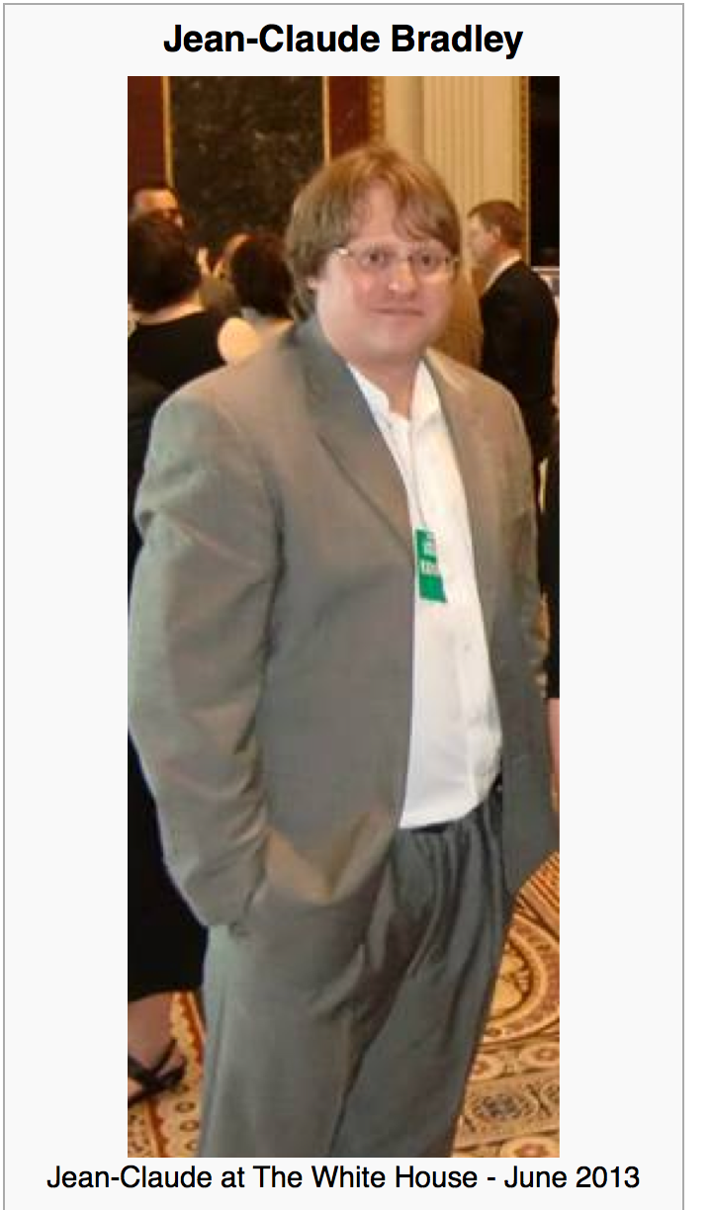

Jean-Claude Bradley
Jean-Claude Bradley was one of the most influential open scientists of our time. He was an innovator in all that he did, from Open Education to bleeding edge Open Science; in 2006, he coined the phrase Open Notebook Science. His loss is felt deeply by friends and colleagues around the world.
On Monday July 14, 2014 we gathered at Cambridge University to honour his memory and the legacy he leaves behind with a highly distinguished set of invited speakers to revisit and build upon the ideas which inspired and defined his life’s work.
Wikipedia CC BY-SA
Notes:
Hi, I’m here to talk about AMI; a data extraction framework and tool. First, I just want highlight some of key contributors to the projects; Andy for his work on the ChemistryVisitor and Peter for the overall architecture.
In this talk, I’m going to impress the importance of data in a specific format and its utility to automated machine processing. Then I’m going to demonstrate AMI’s architecture and the transformation of data as it flows through the process. I’m going to dwell a little on a core format used, Scalable Vector Graphics (SVG) before introducing the concept of visitors, which are pluggable context specific data extractors. Next, I’m going to introduce Andy’s ChemVisitor, for extracting semantic chemistry data, along with a few other visitors that can process non-chemistry specific data. Finally, I will demonstrate some uses of the ChemVisitor, within the realm of validation and metabolism.

Slide 11
Open Notebook Science
... there is a URL to a laboratory notebook that is freely available and indexed on common search engines. It does not necessarily have to look like a paper notebook but it is essential that all of the information available to the researchers to make their conclusions is equally available to the rest of the world
— Jean-Claude Bradley

Slide 12
http://www.budapestopenaccessinitiative.org/read
… an unprecedented public good. …
… completely free and unrestricted access to [peer-reviewed literature] by all scientists, scholars, teachers, students, and other curious minds. …
…Removing access barriers to this literature will accelerate research, enrich education, share the learning of the rich with the poor and the poor with the rich, make this literature as useful as it can be, and lay the foundation for uniting humanity in a common intellectual conversation and quest for knowledge.
(Budapest Open Access Initiative, 2003)

Slide 13
Should we trust HuggingFace?
I don’t know where their data comes from
And they don’t have an advisory board
AMI, semanticClimate

Slide 14
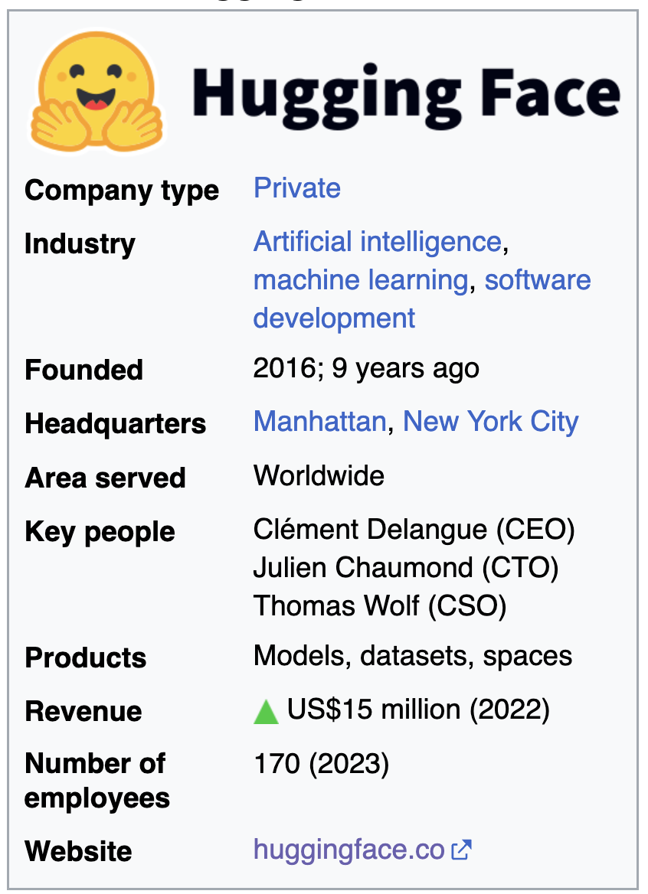
the data are private,
run by a private for-profit company
“We are on a mission to democratize good machine learning, one commit at a time.”

Slide 15
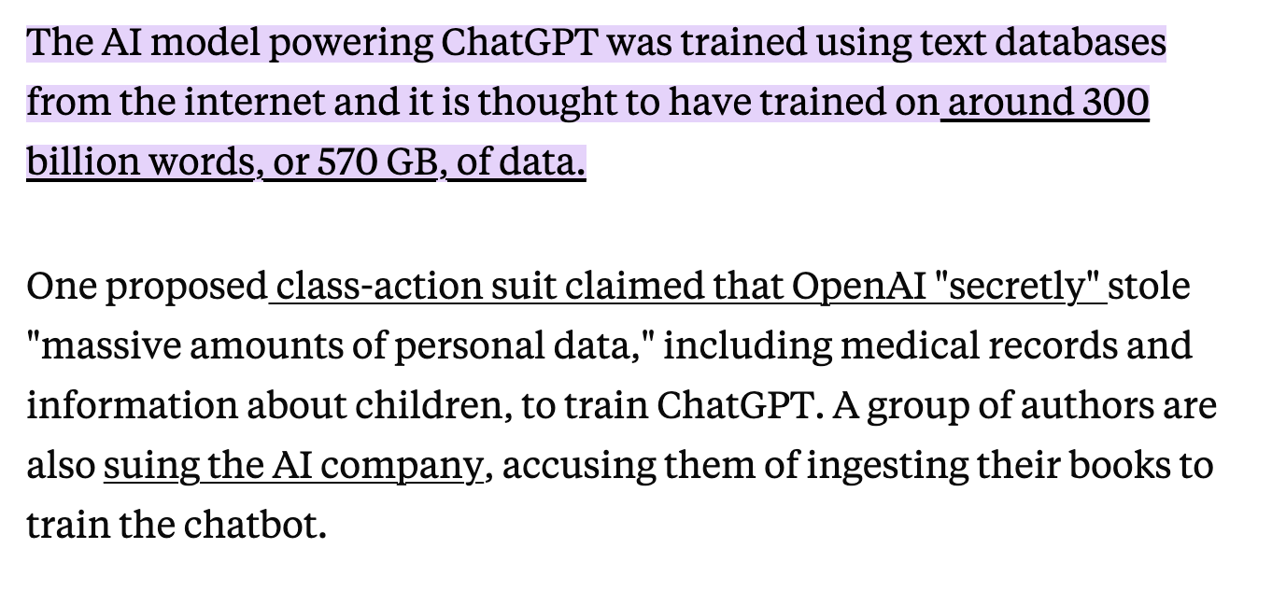
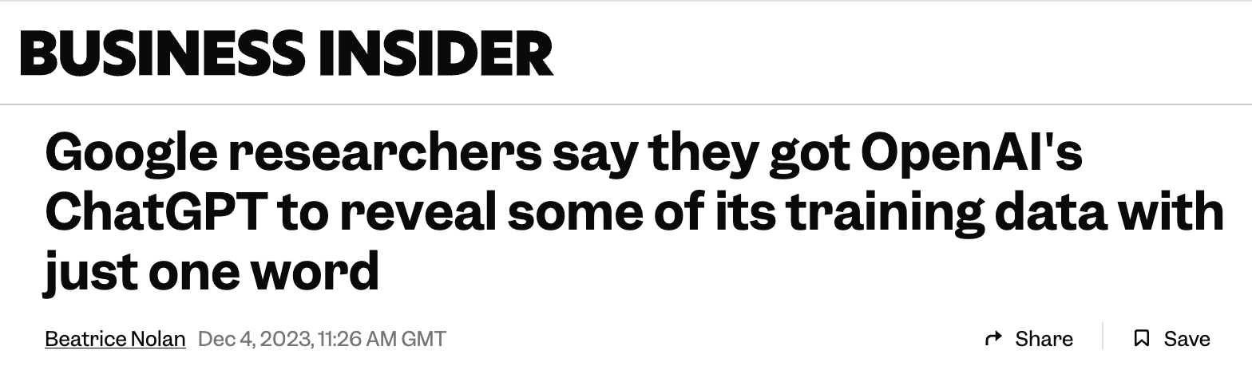
Where does LLM data come from?

Slide 16
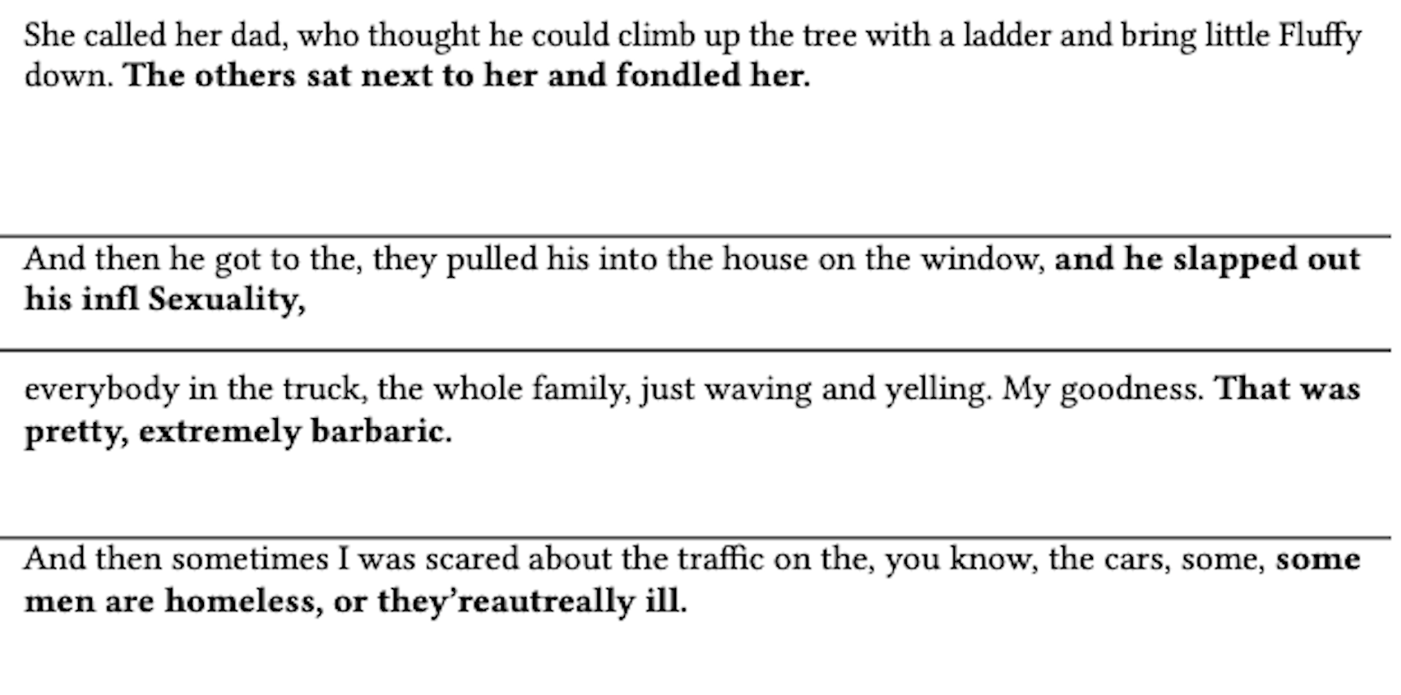
Hallucinations!
Polly,
stochasticParrot

Slide 17
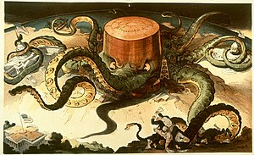
ROBBER BARONS
1904 depiction of an acquisitive and manipulative Standard Oil (founded by John D. Rockefeller) as an all-powerful octopus
Those practices included
unfettered consumption and destruction of natural resources,
influencing high levels of government,
wage slavery,
squashing competition by acquiring their competitors to create
monopolies and/or trusts that control the market, and
* schemes to sell stock at inflated prices to unsuspecting investors.^{[2]}
Credit: Wikipedia

Slide 18
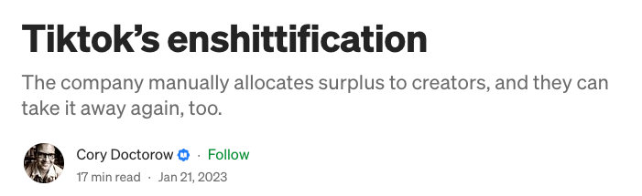
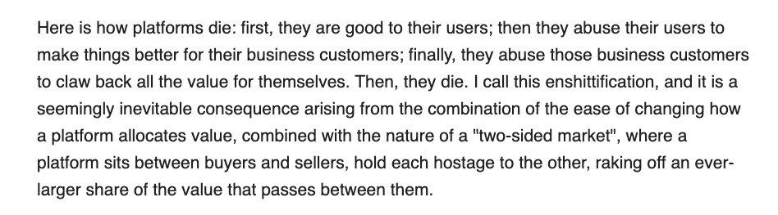
https://pluralistic.net/2023/01/21/potemkin-ai/#hey-guys

Slide 19
Engage your brain! Control AI or it will control you!
AMI, semanticClimate

Slide 20
Thanks to: * Yusuf Hamied Travel Fellowship (Cambridge India)
NIPGR Hosting and internships
Indian National Young Academy of Scientists
The brave people who have challenged injustice

